Slide 1

MICROFLEX Project - Microtechnology in Smart
Fabrics
Electronics and
Computer Science
S Beeby, R Torah, K Yang, Y Wei, J Tudor
Prof Steve Beeby
EEE Research Group
CIMTEC 2012
12th June 2012
Notes:
Please use the dd month yyyy format for the date for example 11 January 2008. The main title can be one or two lines long.

Slide 2
Overview
Introduction to MicroFlex
Functional Inks Development
  Case Study 1: Printed heater on fabric
  Case Study 2: Printed strain gauge on fabric
  Case Study 3: Printed piezoelectrics on fabric
Mechanical Microstructures on Fabric
Conclusions

Slide 3

Research at Southampton
ECS was founded over 60 years ago
100 academic staff (36 professors)
140 research fellows, 250 PhD students
Research grant income: > £12 million p.a.
Over 20 years experience in developing printable active materials
3 ongoing research projects on smart fabrics (2 more completed):
  Microflex (EU Integrated Project)
  Energy Harvesting Materials for SFIT (EPSRC)
  Fabric based medical device (Wessex Medical)
£100 million Mountbatten Building, housing state of the art cleanroom.

Slide 4












MicroFlex Project
The MicroFlex Project is a EU FP 7 funded integrated project, 7.7 M€ Budget, 5.4 M€ funding.
4 Year project, end date 30th October 2012.
13 Partners, 7 industrial, 9 countries.
Develop MEMS processing capability for the production of flexible smart fabrics. Based on screen and inkjet printing.
Develop new functional inks to be compatible with fabrics.
Produce industrial prototypes demonstrating the functionality of the new inks.
http://microflex.ecs.soton.ac.uk

Slide 5
Envisaged Process Flow
Active material
Functional inks
Lab trials
Design & simulation
Screen printing
Curing
Ink jet printing
MEMs on fabric
Fabric
Sacrificial layer removal process
5

Slide 6

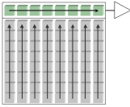
Example Functions and Applications
Drug delivery
Medical
Smart bandage, auto sterilization uniform, active monitoring underwear
Transport
Luminous cabin, smart driver seat,
auto clean filters
Mechanical action
Danger warning workwear (heating suite, high visibility, gas sensing, temperature sensing, movement sensing, alarm sounder
Workwear
Lighting
Sensor
Consumer
Massage and cooling/heating armchair, surroundings customisation
6

Slide 7
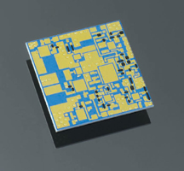

Screen Printing
Also known as thick-film printing, this is normally used in the fabrication of hybridised circuits and in the manufacture of semiconductor packages.
ink
Squeegee
Mesh
Mask
a)
b)
Substrate
Substrate
c)
d)
Substrate
Substrate
7

Slide 8
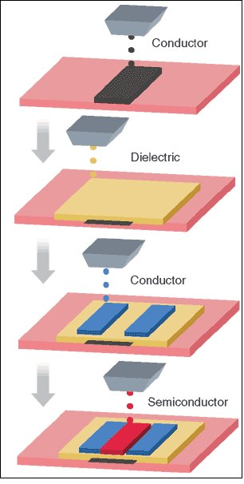
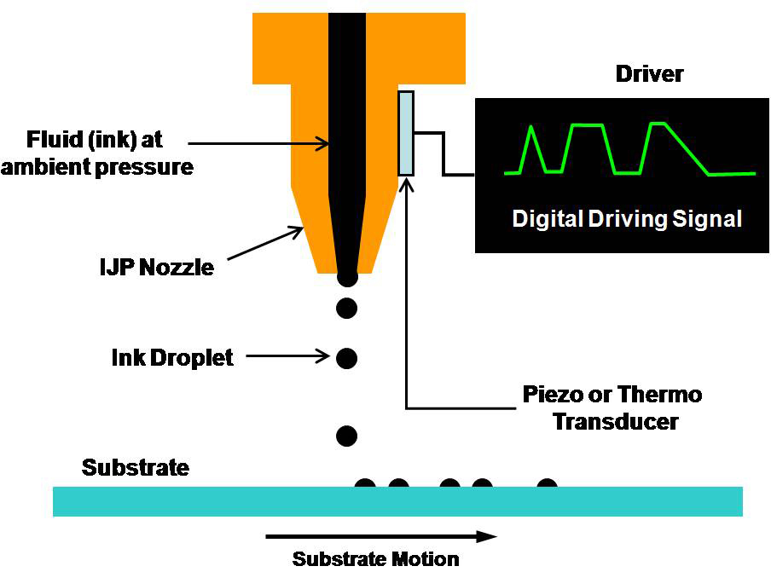
Inkjet Printing
Non contact direct printing onto substrate, used for fabrics and electronics applications.
http://spie.org/x18497.xml?ArticleID=x18497

Slide 9
Functional Inks Development
Research underpinned by novel ink development
Inks need to be flexible, low temperature and robust
Numerous ink types are required:
Passive | Basic functional | Advanced functional
Interface layer | Conductive | Piezoresistive
Encapsulation layer | Dielectric | Piezoelectric
Structural |  | Electroluminescent
Sacrificial |  | Gas sensitive
 |  | Semiconducting

Slide 10
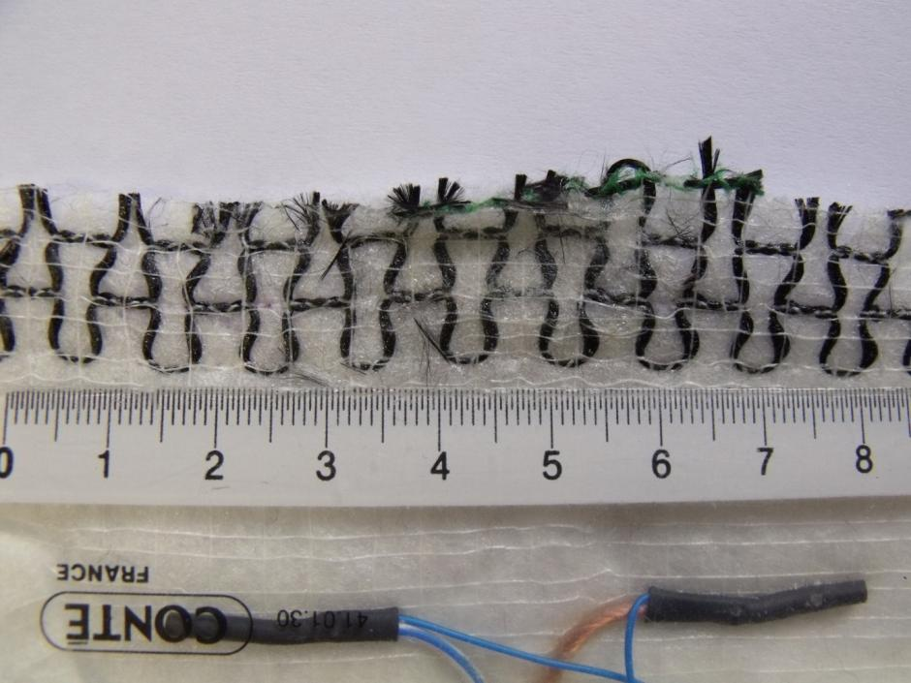
Case Study 1: Printed Heater
Simple heater is a current carrying conductive element.
Existing heaters integrated in textiles by weaving or knitting.
Woven approach limited by direction of warp and weft.
Knitted solution requires specialist equipment .
Heated Car Seat element BMW (www.bmw.com)

Slide 11
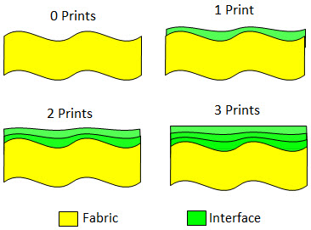
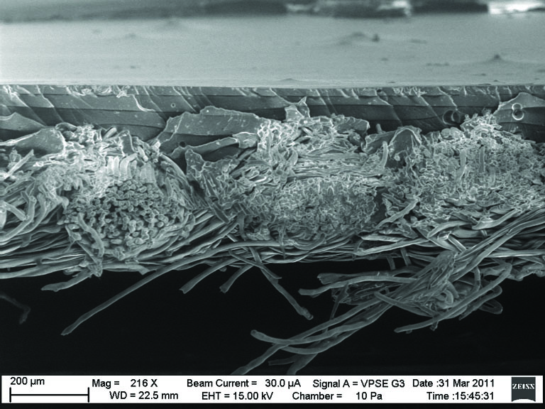
Interface layer
Overcomes surface roughness and pilosity of fabric substrate providing a continuous planar surface for subsequent printed layers.
Cross-section SEM micrograph of 4
screen printed interface layers on
polyester cotton fabric

Slide 12
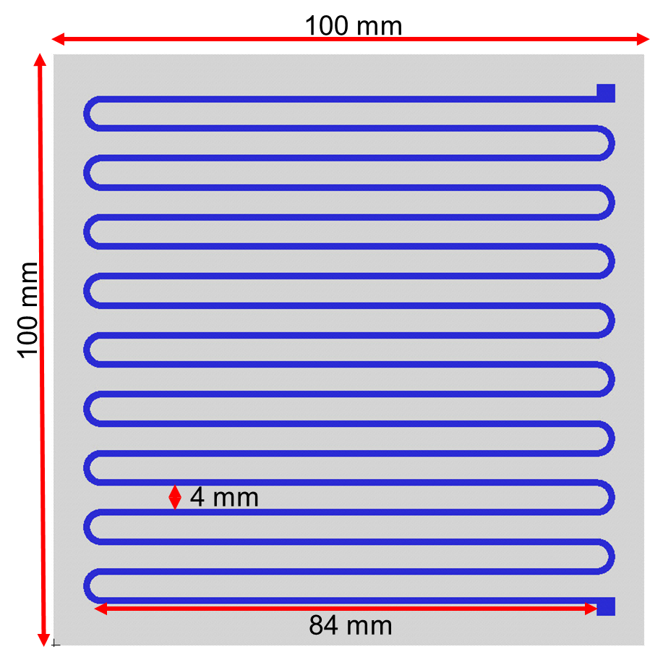
Heater Design
Heater printed on a fabric area of 10 x 10 cm.
Heater should be flexible and maintain the properties of the fabric as much as possible.
Chosen track width of 1 mm for good compromise between conduction and flexibility.
Heater area coverage should be a maximum of 50% of the fabric.
Total track length of 1651.5 mm.
Total area coverage for the heater = 1663.52 mm².
Percentage coverage = 20.5%

Slide 13


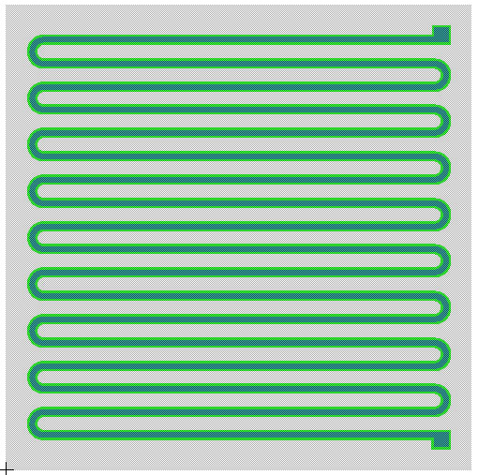
Screen Design
Heater has three layers: Interface, Conductor and Encapsulation.
Interface layer improves heater performance but increases fabric coverage to ~40% - still below limit of 50%.
Encapsulation layer
Conductor layer
Interface layer
Fabric
10cm
Interface screen
Conductor screen
10cm
Complete design

Slide 14

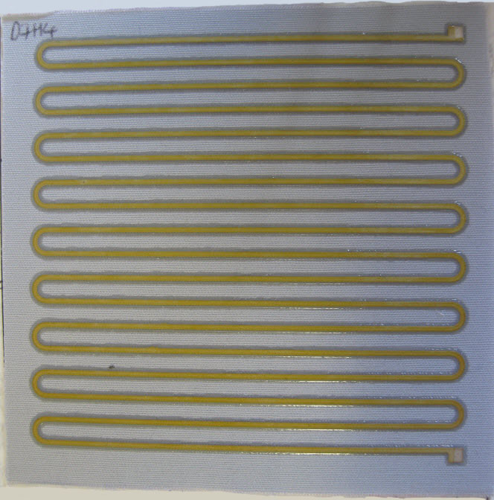

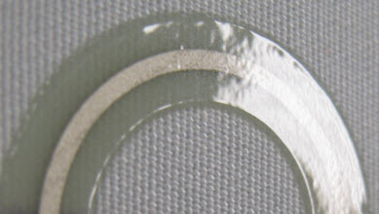
Finished Print
Layers | Printed Thickness
Substrate | Polyester Cotton from Klopman
Interface (Fabink-UV-IF1) | ~120 µm
Conductor (ELX 30UV) | ~7 µm
Encapsulation (Fabink-UV-IF1) | ~40 µm
Interface layer
Conductor layer
Encapsulation layer

Slide 15
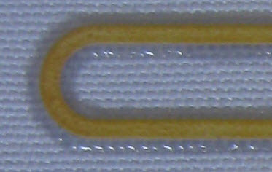
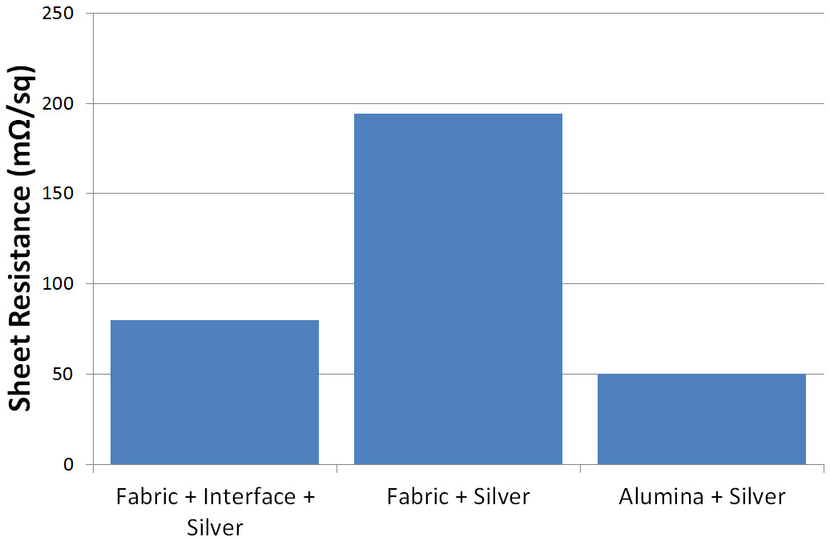
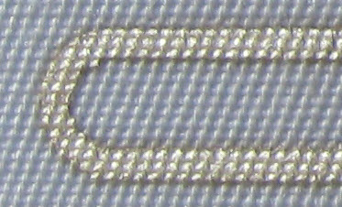
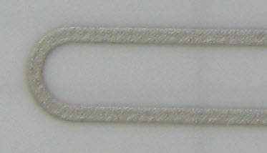
Influence of Interface Layer
Interface
194 mΩ/sq
Fabric
80 mΩ/sq
Alumina
50 mΩ/sq
Printed track on each
substrate
Printed track calculated sheet resistance for each substrate

Slide 16
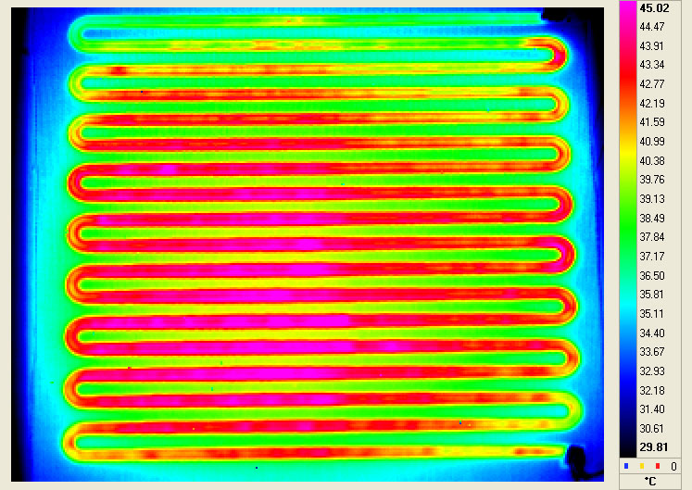
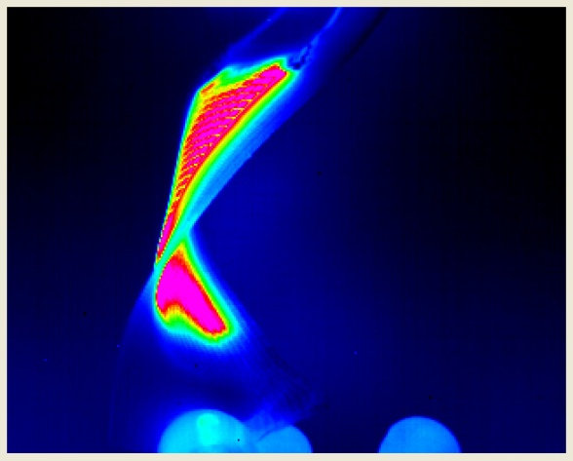
Results
50 ºC heating achieved with 30 V and current limit of 200 mA.
Increases to 120 ºC after 15 minutes with 600 mA current limit.
Fabric temperature within 2% of track temperature.
Low pattern percentage ensures fabric remains flexible and maintains key fabric properties such as breathability and wearer comfort.

Slide 17
Case Study 2: Strain Gauge
Printed strain gauge demonstrated by project partners Jožef Stefan Institute, ink developed by ITCF and fabric from Saati.
Exploits the piezoresistive effect: the resistance of a printed film changes as it is strained (stretched) due to a change in the resistivity of the material.
Useful for sensing movement, forces and strains.

Slide 18
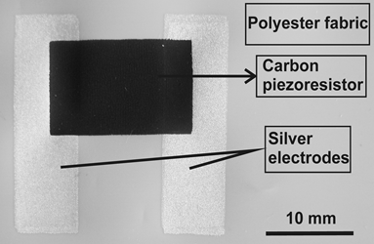
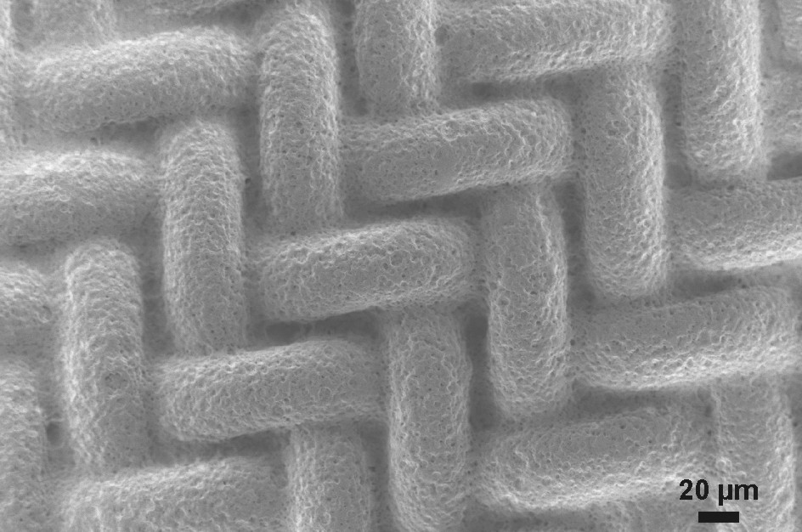
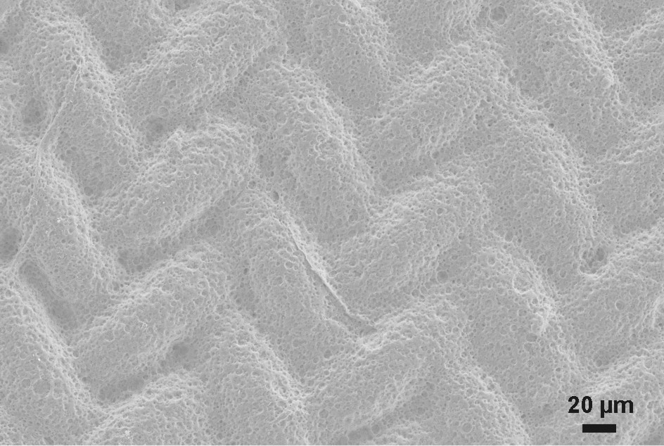
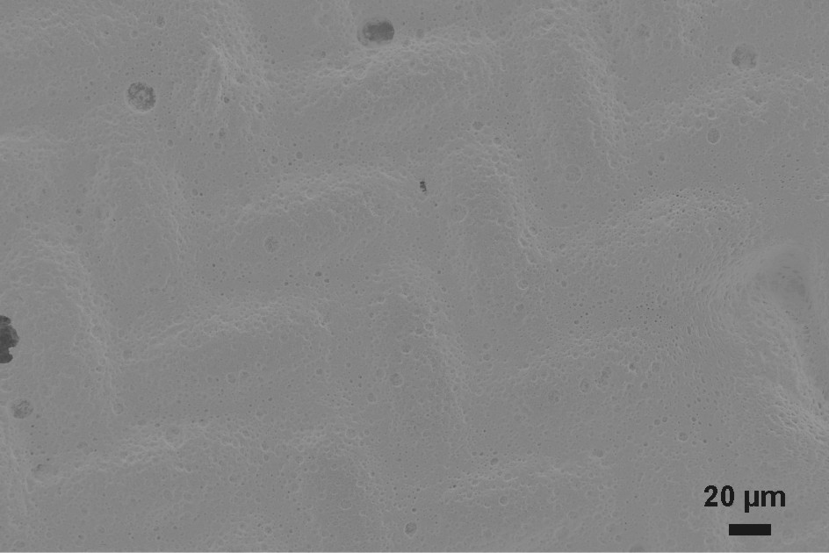
Printed Sensor
Silver electrodes printed using a low temperature polymer silver paste.
Piezoresistive paste is based on graphite.
Cured at 120-125 ºC
1 print
2 prints
3 prints

Slide 19
Results
Sensitivity illustrated by the Gauge factor:
Clear increase in resistance demonstrated as the fabric is strained.
Conventional metal foil GF = 2
N° of graphite layer | R₀ (Ω) at 0 % strain | R(Ω) at 1.5 % strain | Gauge factor
1 | 1905 | 2064 | 5.6
2 | 1100 | 1198 | 5.9
3 | 328 | 358 | 6.1

Slide 20
Strain vs Load
By measuring resistance the load on the fabric can be calculated.
B. Perc, et al. ‘Thick-film strain sensor on textiles’, 45th International Conference on Microelectronics, Devices and Materials - MIDEM, Slovenia 9-11 Sept 2009.

Slide 21
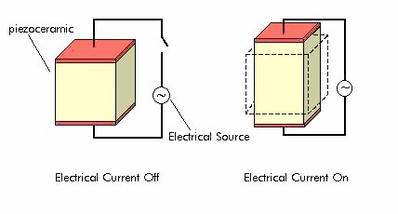
Case Study 3: Piezoelectric Films
Piezoelectric materials expand when subject to an electrical field, similarly they produce an electrical charge when strained.
Ideal material for sensing and actuating applications.
Meggitt have developed a screen printable piezoelectric paste that can be printed onto fabrics.
http://www.piezomaterials.com

Slide 22
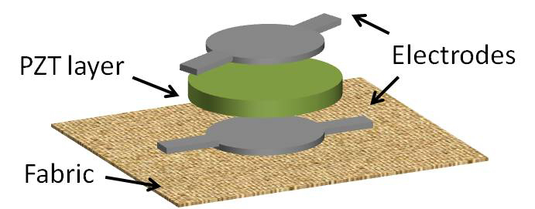
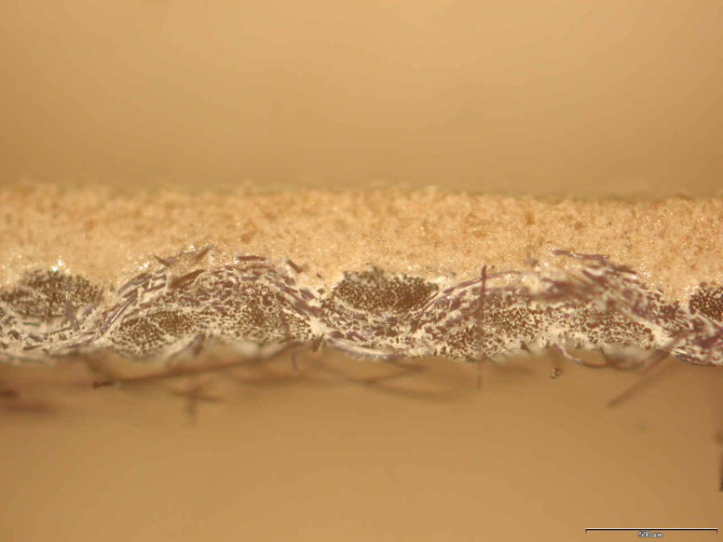
Piezoelectric Structure
Piezoelectric material sandwiched between electrodes.
Polarising voltage required after printing to make the piezoelectric active.
Cured at temperatures below 150 ºC.
Promising sensitivity demonstrated (d₃₃ ~ 30 pC/N)
22
Images courtesy of Meggitt Sensing Systems

Slide 23
Printed MEMS
The MicroFlex project is concentrating on fabricating sensors and actuators (transducers) and developing printed MEMS.
MicroFlex aims to use standard printing techniques and custom inks in order to realise freestanding mechanical structures coupled with active films for sensing and actuating.
Developed a surface micromachining process for printed films on fabrics
23

Slide 24
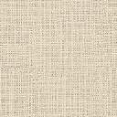
Printed MEMS Process
Structural layer
Electrode
Piezoresistive layer
Sacrificial layer
Fabric
Interface layer
Sacrificial layer requirements: printable, solid, compatible, can be easily removed without damaging fabric or other layers.
Structural layer requirements: suitable mechanical/functional properties.

Slide 25
Process Requirements
Implemented by screen printing.
Sacrificial technology: removal method must be compatible with fabrics i.e. low temperature, non solvent based.
Structural material and its processing must be compatible with the sacrificial material.
Structural materials properties chosen for the particular application.

Slide 26
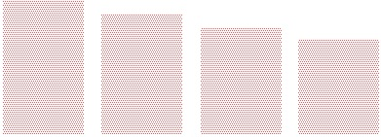
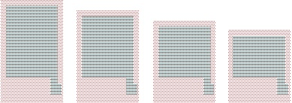
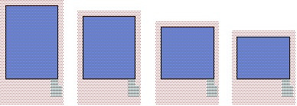
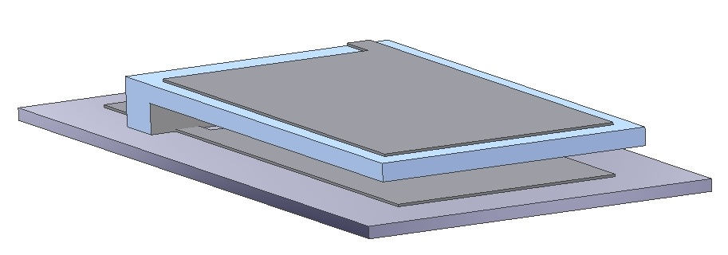
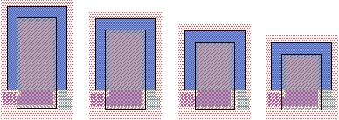
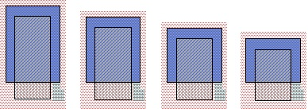
Example Structure
Capacitive Cantilever:
Sample 4 Sample 3 Sample 2 Sample 1
Sample 4 Sample 3 Sample 2 Sample 1
Sample 4 Sample 3 Sample 2 Sample 1
Interface layer
Bottom electrode layer
Sacrificial layer
Sample 4 Sample 3 Sample 2 Sample 1
Sample 4 Sample 3 Sample 2 Sample 1
Top electrode layer
Structural layer

Slide 27
Sacrificial Material and Process
Plastic crystal (Trimethylolethane, TME):
  An intermediate solid form between the real solid and liquid forms
  Sublimation instead of liquefaction
Sublimation starts around 87 ºC
Low curing and removal temperatures
  Curing: 80-85 ºC
  Removal: 150-160 ºC

Slide 28
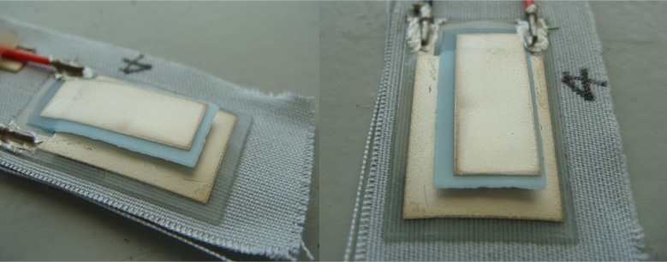
Results
Sacrificial layer was completely removed at 160 ºC.
No visible damage to fabric properties
Resonance test shows cantilever was fully undercut, and results match FEA.

Slide 29
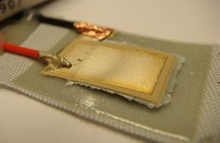
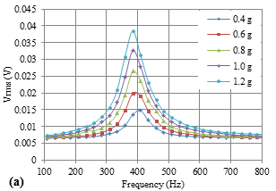
Piezoelectric Cantilever
Piezoelectric version also fabricated
Film thicknesses:
  Interface layer ~100 μm
  Sacrificial layer ~100 μm
  Structural layer ~80 μm
  Electrodes ~15 μm
  PZT 75-100 μm
Voltage versus frequency for different acceleration levels.

Slide 30
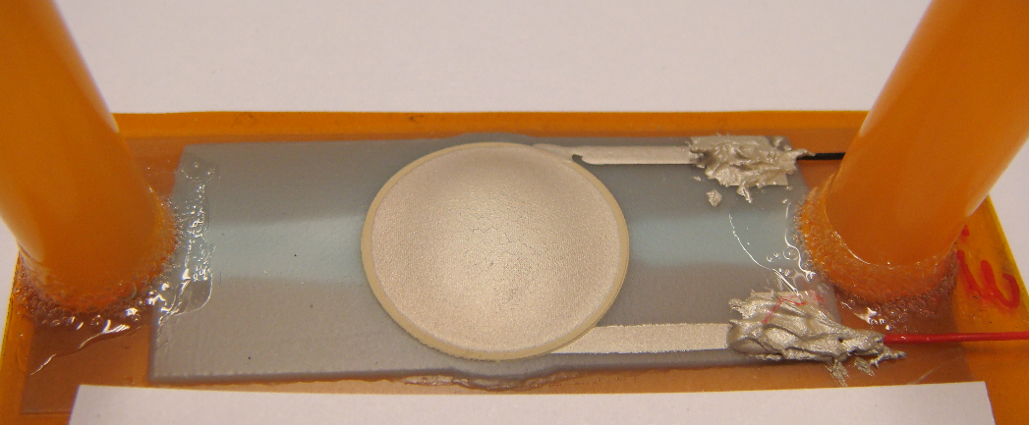
Micropump
Initially printed on Kapton, demonstrates sacrificial process combined with structural, conductive and piezoelectric films.
Uses passive nozzle/diffuser valves, achieves 27 uL/min from 100 V_{P-P} at 1 MHz, pumping IPA.
Chamber
Top electrode
Flow path
PZT layer
Bottom electrode

Slide 31
Conclusions
MicroFlex has developed the materials and processes required to fabricate printed MEMS on fabrics.
Wide range of active inks have been developed.
Numerous prototypes based upon these active inks demonstrated.
Sacrificial layer fabrication process has also been demonstrated and is being applied to several structures and devices including accelerometers, pressure sensors and micropumps.

Slide 32

Smart Fabric Inks Ltd
Company launched February 2011
Marketing inks developed at the University of Southampton
Please visit www.fabinks.com for further information

Slide 33
Acknowledgements
Colleagues at Southampton, MicroFlex partners and EU for funding (CP-IP 211335-2).
  Thanks for your attention!

